Slide 1
Introduction to Year 7 RE
Learning Objectives:
KNOW key features of some religions
UNDERSTAND how religions are different
BE ABLE TO identify different features from different religions
The words below are used to describe people who belong to different religions - unfortunately the letters are all jumbled up – can you unjumble them to identify 6 people who belong to different religions …
CHAIRSNIT
MILSUM
WEJ
KISH
THUDBIDS
DUNHI
Key Words
?

Slide 2
Introduction to Year 7 RE
Learning Objectives:
KNOW key features of some religions
UNDERSTAND how religions are different
BE ABLE TO identify different features from different religions
The words below are used to describe people who belong to different religions - unfortunately the letters are all jumbled up – can you unjumble them to identify 6 people who belong to different religions …
Check your answers:
CHAIRSNIT CHRISTIAN
MILSUM MUSLIM
WEJ JEW
KISH SIKH
THUDBIDS BUDDHIST
DUNHI HINDU
Key Words
?

Slide 3
Introduction to Year 7 RE
Learning Objectives:
KNOW key features of some religions
UNDERSTAND how religions are different
BE ABLE TO identify different features from different religions
On the next slide there are 24 images relating to the 6 religions you will study in year 7 at KEVI.
There is a sacred building, a sacred book, a festival and sacred teacher or leader from every religion.
Your challenge is to work out which belongs to which religion and to organise them so that you know what the sacred buildings, sacred books, festival and sacred teacher or leader for each religion is.
The pictures should give you clues.
Either cut them out and stick them onto a separate piece of paper in a table format (see slide 5) or cut and paste them from slide 4 onto slide 5
Key Words
Christian
Buddhist
Judaism
Islam
Hindu
Sikh
Stretch and Challenge
Research other festivals / leaders / texts and see if you can name some more

Slide 4
Introduction to Year 7 RE
Learning Objectives:
KNOW key features of some religions
UNDERSTAND how religions are different
BE ABLE TO identify different features from different religions
The answers are on slide 7 if you need a bit of help
Key Words
Christian
Buddhist
Judaism
Islam
Hindu
Sikh
Stretch and Challenge
Research other festivals / leaders / texts and see if you can name some more

Slide 5
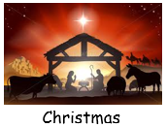
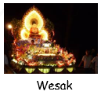
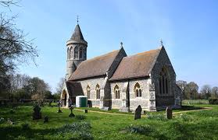
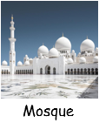
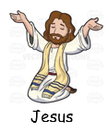
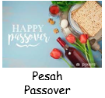
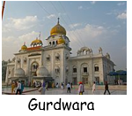
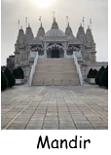
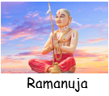
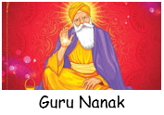
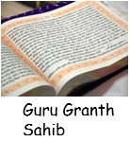
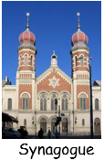
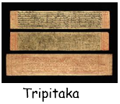
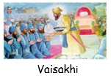

Slide 6
Name of Religion | Person who belongs to that religion | Religious leader / teacher | Religious book | Religious building | Religious festival
Christianity | Christian
Judaism | Muslim
Islam | Buddhist
Buddhism | Jew
Sikhism | Hindu
Hinduism | Sikh

Slide 7
Name of Religion | Person who belongs to that religion | Religious leader / teacher | Religious book | Religious building | Religious festival
Christianity | Christian
Judaism | Jew
Islam | Muslim
Buddhism | Buddhist
Sikhism | Sikh
Hinduism | Hindu

Slide 8
Introduction to Year 7 RE
Learning Objectives:
KNOW key features of some religions
UNDERSTAND how religions are different
BE ABLE TO identify different features from different religions
Well done – you are now a bit more “Ready for KEVI”
Key Words
Christian
Buddhist
Judaism
Islam
Hindu
Sikh

