Slide 1
English Department
Deadline: The end of term
Theme: Survival Stories
Prize: You story will be printed in the Edwardian – our school newsletter!

Slide 2
This Y6 transition unit is designed to find the most creative writers who will be joining us at KEVI in September!
The theme for this competition is ‘Survival Stories’.
Your task will be to produce your own survival stories based on some of the examples you have looked at in lessons or at home.
Your story could describe a crash landing, somebody marooned on a desert island, somebody lost in the wilderness, somebody stranded at sea, or any other story of survival you can come up with!
Your story must be under 100 words, and should be written up in neat on the entry form which your teachers have copies of. Your teachers will pass on their favourite entries to the English department at KEVI (lomas.j1@kevi.org.uk) and we will announce the winders in September!
The overall winner will get a huge box of sweets and will have their story printed in the Edwardian, our school newsletter!

Slide 3
How can I begin to explore what makes a compelling survival story?
(Where are you on the arrow?)
RED
I’m not sure what a survival story is and I can’t think of any examples.
AMBER
I understand what a survival story is and I can think of examples, but I’m not sure what makes them compelling.
GREEN
I have started to explore survival stories and what makes them compelling.

Slide 4
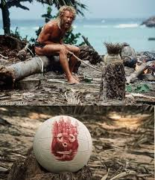
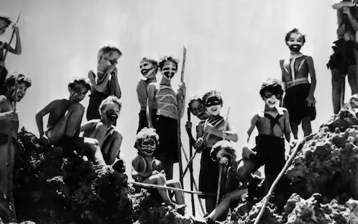
Survival Stories
What do you think we mean by this?
What different situations might people find themselves in where they would have to fight for survival?
Can you think of any examples of TV Shows, Movies or Books where the characters/character finds themselves in this situation?
Extension: Why do you think these kinds of story are so popular?

Slide 5
What if…
Consider these hypothetical situations with the person next to you.
What would you do if…
The plane you were travelling in crash landed on a desert island and you were the only survivor.
You were stranded on a lifeboat at sea.
Your arm was trapped under a rock in the middle of the desert.
You and a group of your friends from school were stranded on a deserted island.

Slide 6
What makes an effective survival story?
What do you think we need?
Intimidating Settings
Character Development
Disastrous Situations
A suspenseful Cliff-hanger

Slide 7
Real-life Survival Stories
You will be coming up with your own fictional survival stories, however sometimes real life can be stranger than fiction!
https://www.youtube.com/watch?v=IwwB899tN34
Pick one of these 10 stories to create a short description of.

Slide 8
Real-Life Survival Films
Choose one of these films based on real-life events and write a short description of something that might have happened to you or that you might have gone through from the perspective of one of the survivors.
#10. “Open Water” (2003)
#9. “White Squall” (1996)
#8. “The Perfect Storm” (2000)
#7. “The Way Back” (2010)
#6. “RabbitProof Fence” (2002)
#5. “Rescue Dawn” (2006)
#4. “Touching the Void” (2003)
#3. “Into the Wild” (
#2. “Alive” (1993)
#1. “127 Hours” (2010)

Slide 9
What makes an effective survival story?
Answer this question in full in your books.

Slide 10
How can I begin to explore what makes a compelling survival story?
(Where are you on the arrow?)
RED
I’m not sure what a survival story is and I can’t think of any examples.
AMBER
I understand what a survival story is and I can think of examples, but I’m not sure what makes them compelling.
GREEN
I have started to explore survival stories and what makes them compelling.

Slide 11
How can I create a detailed and intimidating setting for my survival story?
(Where are you on the arrow?)
RED
I’m not sure what makes for an intimidating setting.
AMBER
I understand what makes for an intimidating setting, but I’m not sure how to create my own.
GREEN
I have created my own detailed and intimidating setting for my survival story.

Slide 12
What makes an effective survival story?
What do you think we need?
Intimidating Settings
Character Development
Disastrous Situations
A suspenseful Cliff-hanger

Slide 13
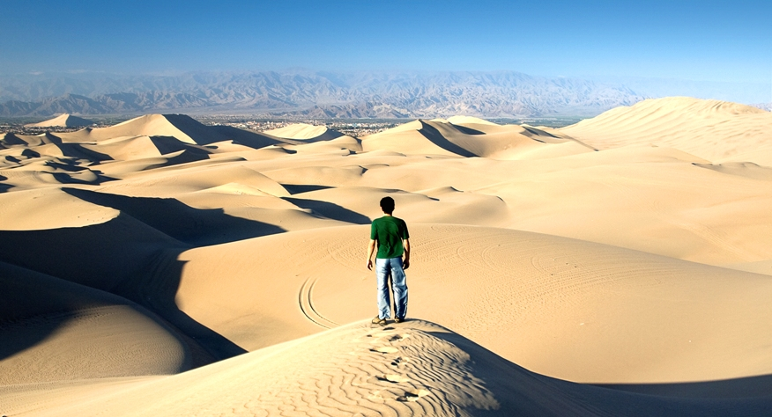
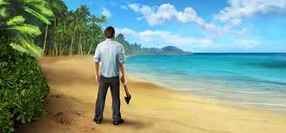
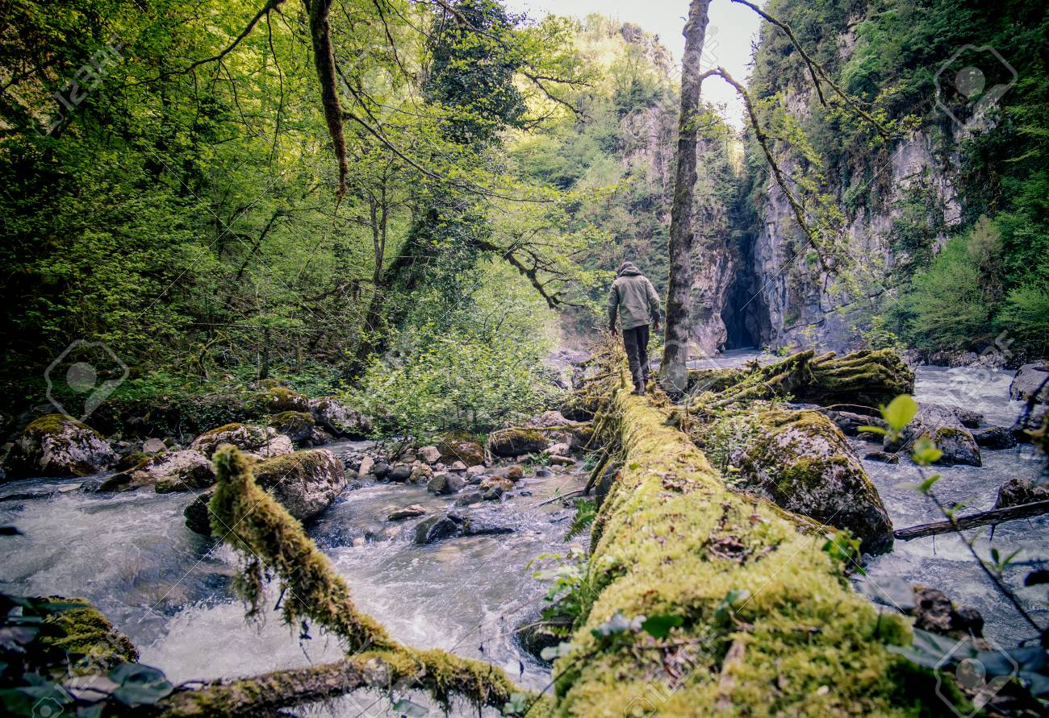
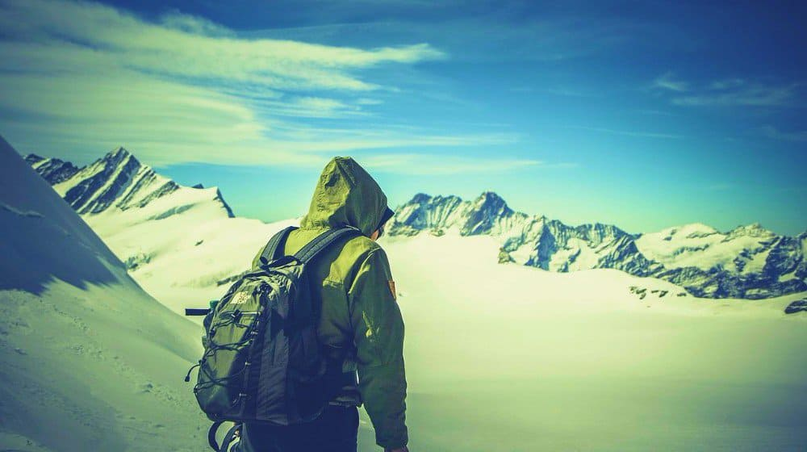
Imagine you are the character in one of these four survival settings. Come up with three ambitious words to describe something you can see, hear, feel, smell etc…

Slide 14
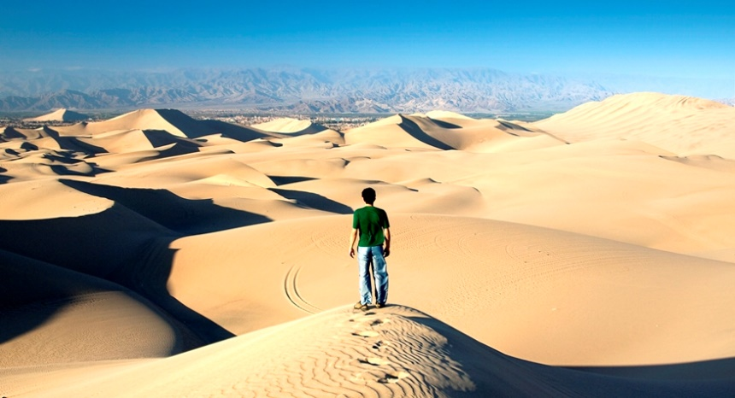
Your survival setting…
Where will your survival story take place? (Desert Island, Wilderness, Desert, Forest, Arctic)
How can you make this setting sound intimidating?
Find an image of a setting you would like to use on your phone.

Slide 15
Your image…
Using the image you found on your phone, write a detailed description of the setting for your survival story.
Write it in first person, as if you are standing in the image, like the people in the picture on the right.
Success Criteria:
1st Person
Sensory Descriptions
Ambitious Vocabulary
Simile/Metaphor
Intimidating Personification
Foreshadowing

Slide 16
Peer Assess
Success Criteria:
1st Person
Sensory Descriptions
Ambitious Vocabulary
Simile/Metaphor
Intimidating Personification
Foreshadowing
How could your partner make their setting more intimidating using one of the criteria?

Slide 17
How can I create a detailed and intimidating setting for my survival story?
(Where are you on the arrow?)
RED
I’m not sure what makes for an intimidating setting.
AMBER
I understand what makes for an intimidating setting, but I’m not sure how to create my own.
GREEN
I have created my own detailed and intimidating setting for my survival story.

Slide 18
How can I begin to develop some subtle characterisation in my piece?
(Where are you on the arrow?)
RED
I’m not sure how to create characterisation.
AMBER
I understand how to create characterisation, but I’m not sure how to do this subtly.
GREEN
I have created a character and subtly used characterisation to present him/her.

Slide 19
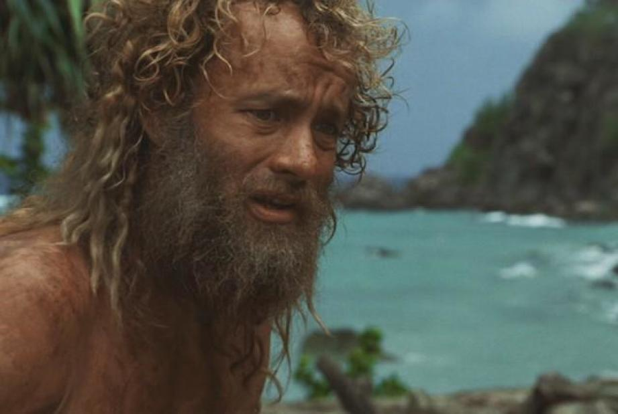
Describe this man’s thoughts and feelings using show don’t tell. NO abstract nouns allowed.

Slide 20
Your Character – The Basics
Name:
Age:
Occupation:
Physical Description:
Do we actually need to include all of this info in our 100 words?
What information DO we need to include about our character to make our stories more effective or to make the reader care about the character?

Slide 21
Your Character – Pathos
Pathos is what makes us feel sorry for our character and want them to survive.
How can we make people feel pathos for our characters when they get in trouble?
Plan out a moment of pathos you could include to make the reader care about your character.
E.g looking at apicture of their family on their phone before the battery dies.
Helping a wounded animal.

Slide 22
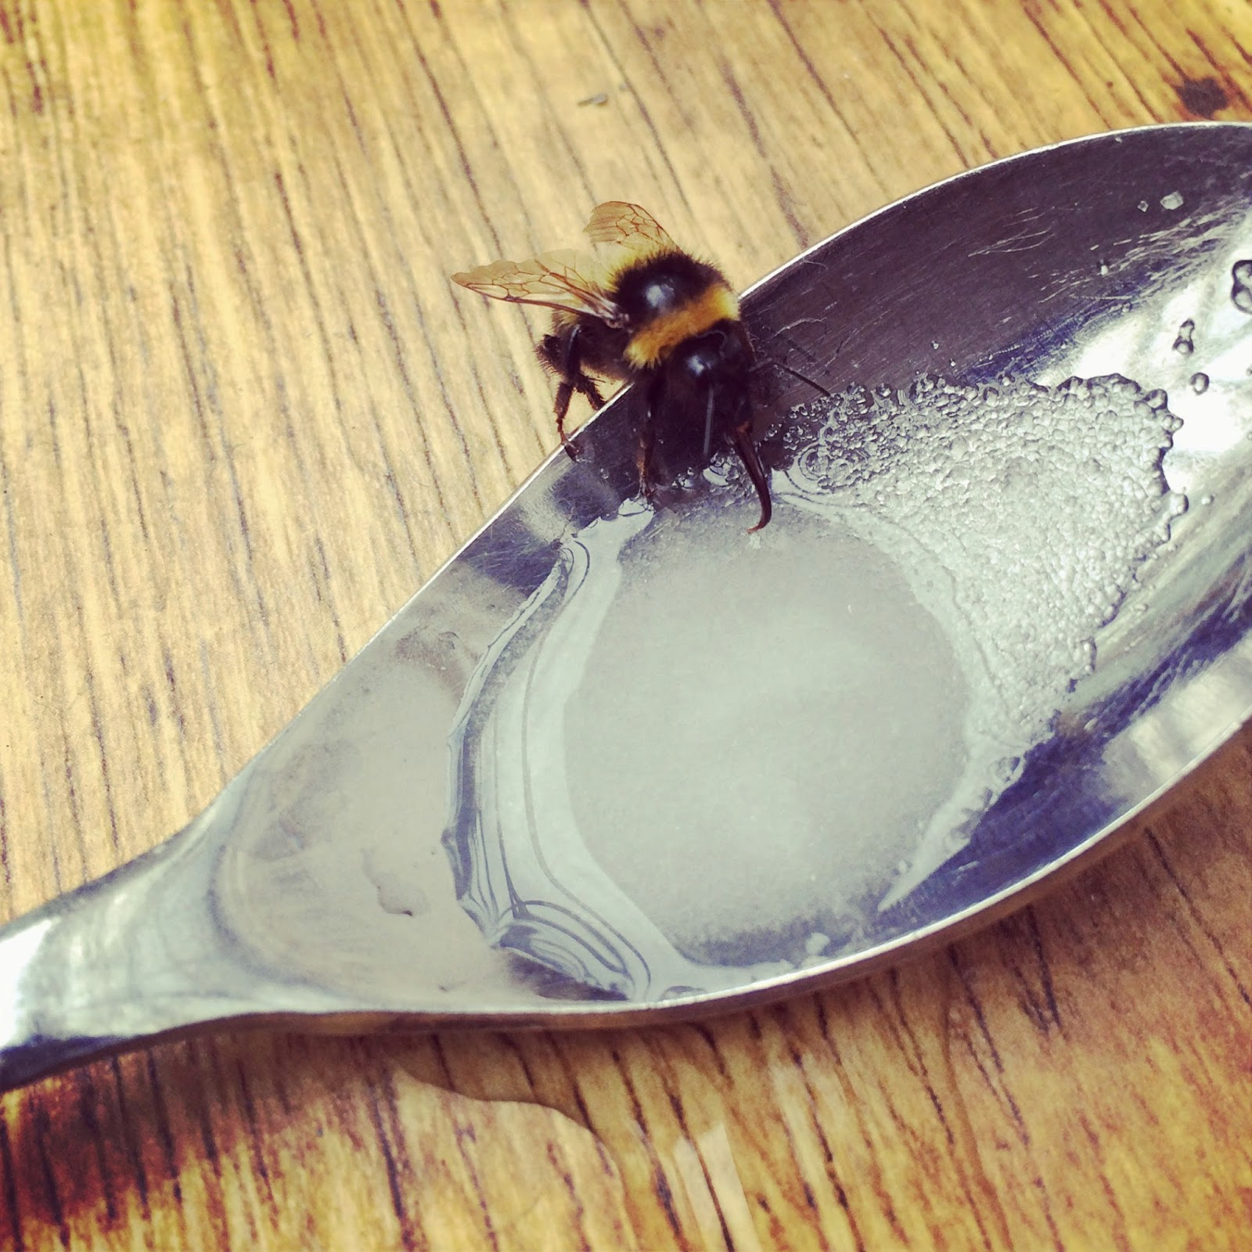
Write Up
Write up a moment of pathos that could happen in your story before your disastrous situation takes place. For example:
A kind act
An emotional moment
Peer assess:
How has your partner achieved pathos in their story?
What could they add or change to make us care even more?

Slide 23
How can I begin to develop some subtle characterisation in my piece?
(Where are you on the arrow?)
RED
I’m not sure how to create characterisation.
AMBER
I understand how to create characterisation, but I’m not sure how to do this subtly.
GREEN
I have created a character and subtly used characterisation to present him/her.

Slide 24
How can I come up with a disastrous situation and a suspenseful cliff-hanger?
(Where are you on the arrow?)
RED
I’m not sure what will happen in my story or how I’ll end it.
AMBER
I know what will happen in my story but I’m not sure how to make it suspenseful.
GREEN
I have come up with a disastrous situation and a suspenseful cliff-hanger.

Slide 25
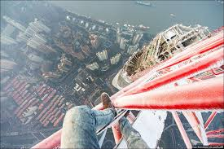
Perilous
What does this word mean?
Can you think of any examples of perilous situations?

Slide 26
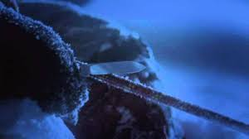
Touching the Void
https://www.youtube.com/watch?v=pqmYP0OmHcw
Watch this clip from Touching the Void.
You are going to write a description of this moment from the perspective of one of the two men (it’s up to you which you choose)
Like a gothic story, you must build up the tension, and you might want to leave it on a cliff-hanger (e.g, getting the knife out and staring at the blade, or hearing the cutting sound vibrating down the rope).

Slide 27
Your Story
Using the scene from touching the void as inspiration, plan out what your disastrous situation will be and how you will end it on a suspenseful cliff-hanger.
You can begin writing this out once you’ve planned it.

Slide 28
How can I come up with a disastrous situation and a suspenseful cliff-hanger?
(Where are you on the arrow?)
RED
I’m not sure what will happen in my story or how I’ll end it.
AMBER
I know what will happen in my story but I’m not sure how to make it suspenseful.
GREEN
I have come up with a disastrous situation and a suspenseful cliff-hanger.

Slide 29
Write-ups
In your books, write up your four sections all together.
Now, think about whether your sections fit as a story and whether there are any last minute changes you could make to make them even more tense/effective/emotive. Mark these on in red pen.
How many words have you written? How can you get under 100 words?
Re-write a final neat draft in your book with these changes.
Double check your spellings and your word count, and then I’ll come around with the competition sheet to write on.

